Slide 1
IoT SECURITY THREATS
Exploratory Data Analysis of IoT Security Threats and Attack Patterns
Python Data Analysis Project | RT-IOT2022 Dataset
Industry:
IoT Cybersecurity
Course:
AIML
Student Name:
Madhumidhaa A P
Batch Code:
ANP-D7444
Student ID:
AF05308674

Slide 2
Industry Overview
IoT
Selected industry: Internet of Things cybersecurity
About the industry
IoT links devices such as sensors, smart bulbs and MQTT-based systems over TCP/UDP networks.
Rapid growth in connected devices has raised the importance of network security.
Large traffic volumes make manual spotting of abnormal behavior difficult.
24/7
Connected devices continuously generate network traffic
Why data analysis matters
Reveals which attacks dominate and which protocols they use.
Turns raw traffic logs into insights for threat detection.
Builds the base for ML-based attack classification.
85
Traffic features per record in the dataset studied
2

Slide 3
Problem Statement
The Problem
Why It Matters
Who Is Affected
IoT traffic mixes many devices, protocols and services. Malicious activity shows different behavioral patterns, so threat analysis is hard, and raw traffic data needs systematic cleaning and exploration first.
Undetected attacks (DoS floods, ARP poisoning, scans, brute force) can disrupt devices and networks. Data-driven understanding of attack patterns supports better defense.
Network and security teams, IoT device owners and manufacturers, and organizations relying on connected infrastructure.
3

Slide 4
Project Objectives
1
Understand the structure and quality of the RT-IOT2022 dataset
2
Handle missing values, duplicates and inconsistent categorical values
3
Analyze attack type, protocol and service distributions
4
Study flow duration, packet behavior and outliers
5
Examine correlations between network traffic features
4

Slide 5
Proposed Solution & Analysis Questions
Proposed solution
Analysis questions
Use Python (Pandas, NumPy, Matplotlib, Seaborn in Jupyter) to clean the traffic data, explore it statistically and visualize patterns. Workflow: load → inspect → clean → EDA → visualize → interpret. The cleaned dataset prepares the ground for feature engineering and classification in Sprint 2.
Q1
Which attack types are most common?
Q2
Which network protocols dominate the traffic?
Q3
How is flow duration distributed, and are there outliers?
Q4
Which attack types appear on which protocols?
Q5
Which traffic features are strongly correlated?
5

Slide 6
Dataset Information
123,367
85
CSV
Important features
proto
service
flow_duration
fwd_pkts_tot
bwd_pkts_tot
flow_pkts_per_sec
payload_bytes_per_second
down_up_ratio
Attack_type (target label)
Rows (raw)
Columns (raw)
File format
Dataset
Name: RT-IOT2022 (uncleaned practice copy: RT_IOT2022_uncleaned_practice.csv)
Source: public RT-IOT2022 IoT network traffic dataset (UCI repository)
Each record is one network traffic observation with protocol, service, packet, flow, rate and attack-category fields.
6

Slide 7
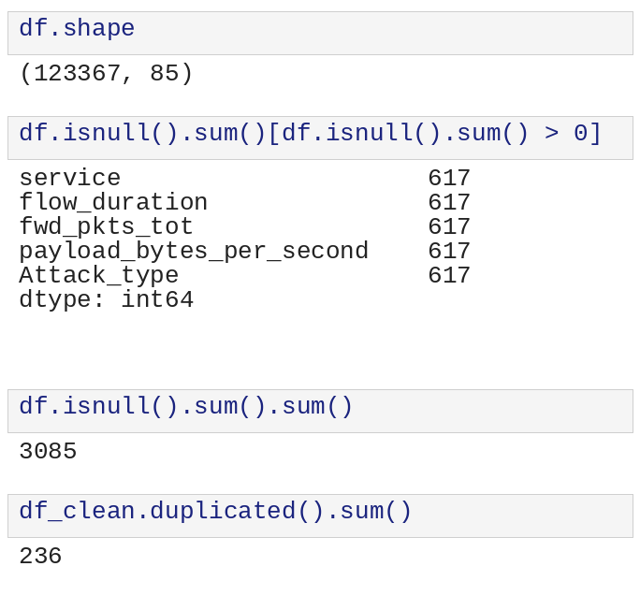
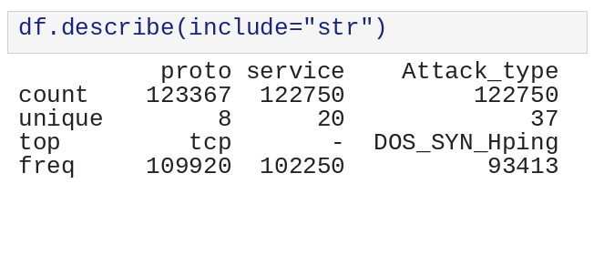
Data Collection & Understanding
Collected: RT-IOT2022 CSV loaded with pd.read_csv()
Shape: 123,367 rows × 85 columns
Dtypes: 57 float64, 25 int64, 3 text (proto, service, Attack_type)
Missing: 3,085 values in 5 columns (617 each); 3,055 rows affected (~0.5%)
Duplicates: 236 exact duplicate rows found at first check
Categorical: 8 proto values, 20 services, 37 attack labels (case variants)
7

Slide 8
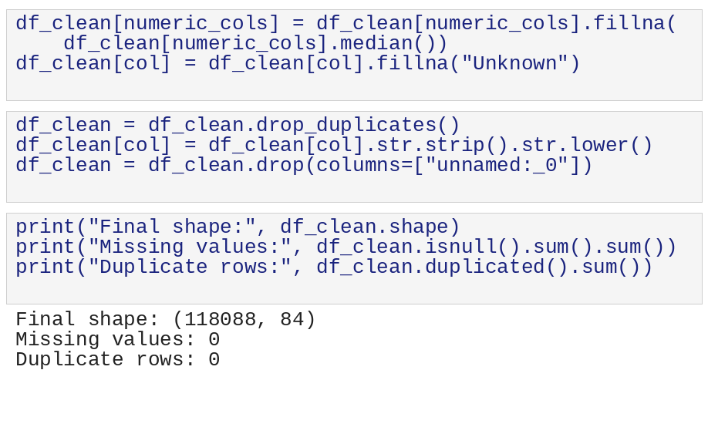
Data Cleaning & Transformation
Missing values: numeric filled with median; text filled with "Unknown" → 0 missing
Duplicates: drop_duplicates() removed 236, then 7 more after standardizing
Inconsistent text: strip() and lower() on proto, service, attack type
Data types: flow_duration converted with pd.to_numeric
Column names: stripped, lowercased, spaces → underscores
Dropped redundant index column "unnamed:_0"; 5,036 further duplicates removed
Result: 118,088 rows × 84 columns, 0 missing, 0 duplicates
8

Slide 9
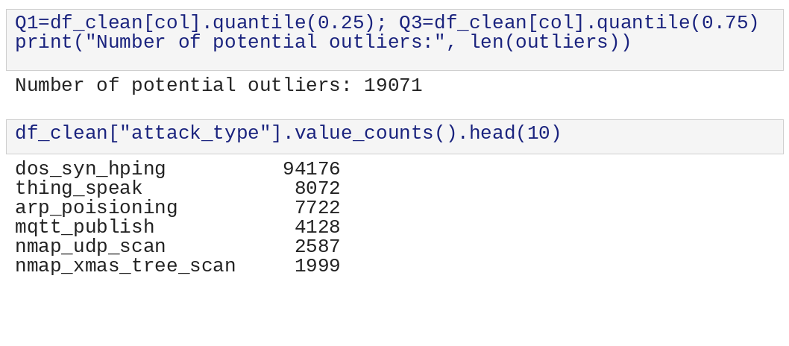
Exploratory Data Analysis (EDA)
Libraries & methods
Pandas (value_counts, crosstab, describe, corr, IQR) · NumPy · Matplotlib · Seaborn
Findings
Attack labels shrank from 37 raw variants to 13 categories after standardizing
dos_syn_hping is the top attack type
IQR check flagged 19,071 potential flow_duration outliers
Raw flow_duration: median ≈ 0.000004 s vs max ≈ 21,728 s, so it is very skewed
No negative values in flow_duration or fwd_pkts_tot
Output shown before the final de-duplication step.
9

Slide 10
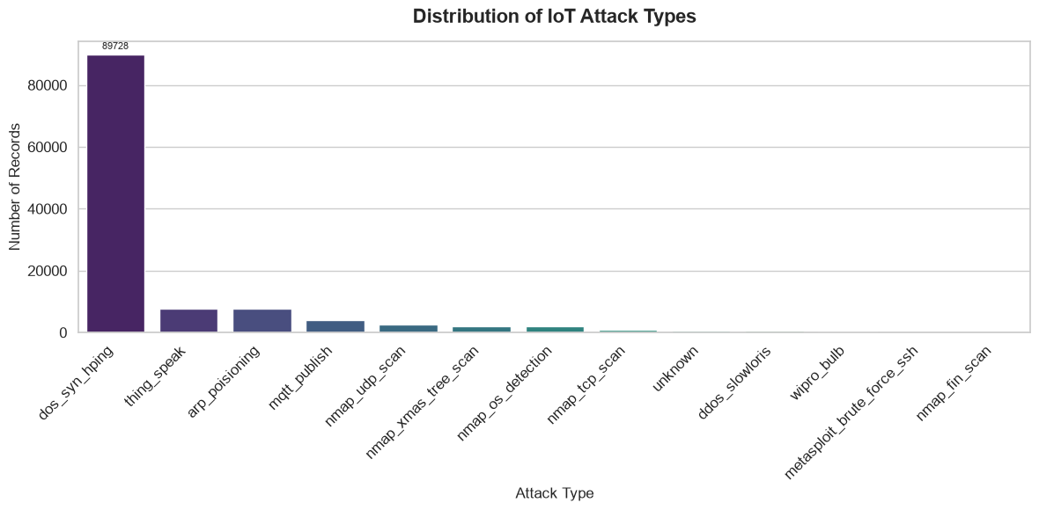
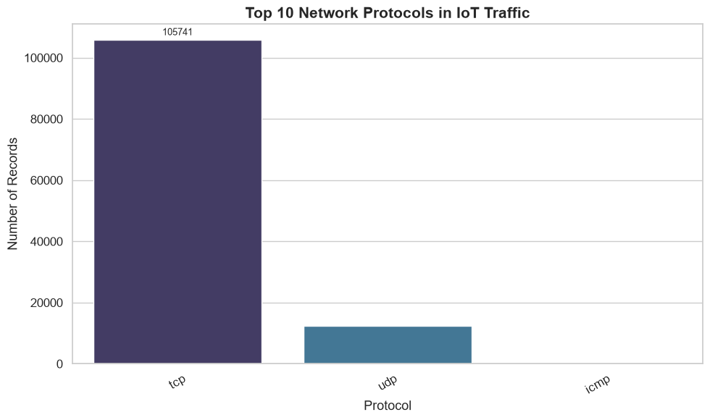
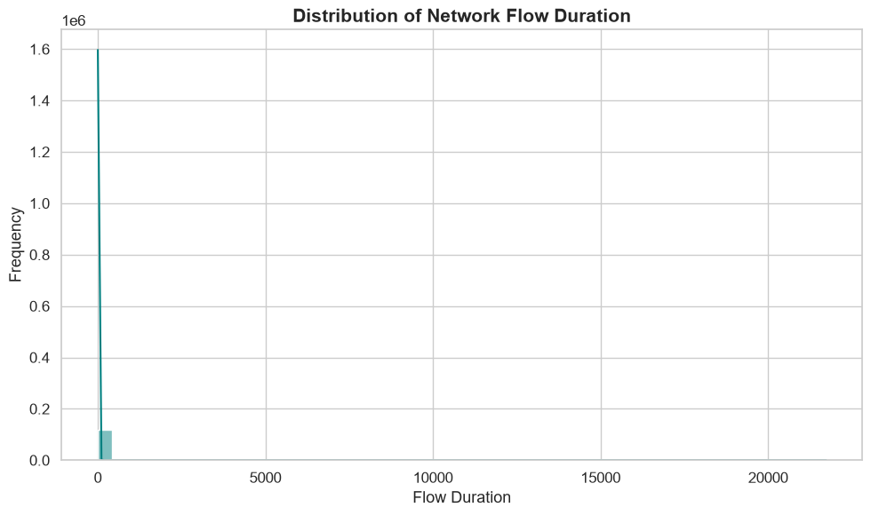
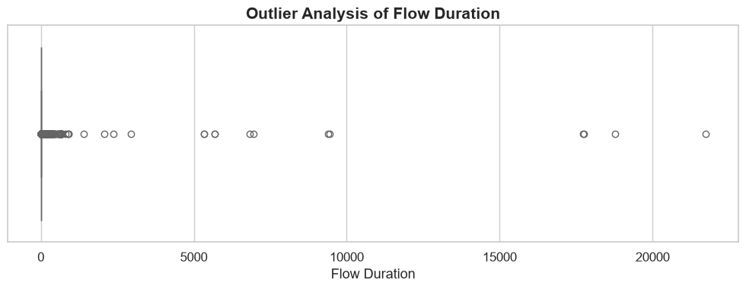
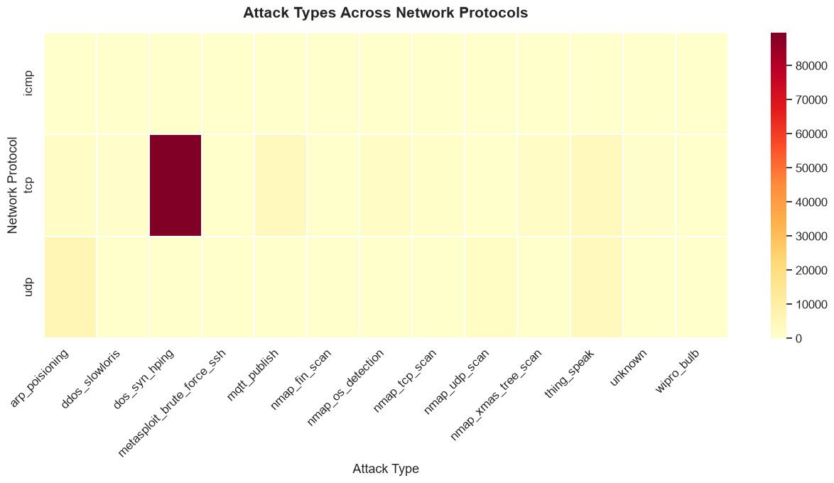
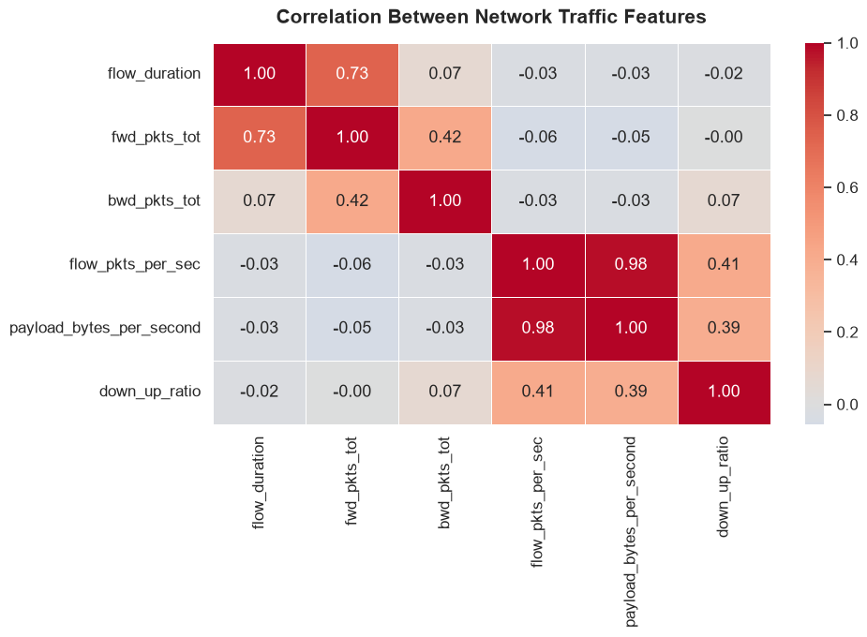
Data Visualization
1. Attack Type Distribution
Purpose: To find dominant threats
Shows: Records per attack type (bar)
Insight: dos_syn_hping = 89,728 records (~76%)
2. Protocol Distribution
Purpose: To see protocol usage
Shows: Records per protocol (bar)
Insight: TCP leads with 105,741 (~89.5%), then UDP, ICMP
3. Flow Duration Histogram
Purpose: To see typical flow length
Shows: Frequency of flow durations
Insight: Almost all flows are very short; long tail to ~21,728 s
4. Flow Duration Boxplot
Purpose: To spot outliers
Shows: Spread and extreme values
Insight: Extreme high values; 19,071 IQR outliers flagged
5. Attack vs Protocol Heatmap
Purpose: To link attacks with protocols
Shows: Record counts, protocol x attack
Insight: dos_syn_hping is concentrated on TCP
6. Correlation Heatmap
Purpose: To find related features
Shows: Correlation of 6 traffic features
Insight: Packet rate vs payload rate r = 0.98; duration vs fwd pkts 0.73
10

Slide 11
Key Insights & Recommendations
Key insights
Recommendations
One attack dominates: dos_syn_hping is ~76% of 118,088 cleaned records
TCP carries ~89.5% of traffic (105,741 records)
Flow duration is highly skewed, with 19,071 IQR outliers
Packet rate and payload rate move together (r = 0.98)
Forward packets track flow duration (r = 0.73)
Treat class imbalance (rebalancing) before modelling
Apply log scaling to skewed duration features
Drop one of the 0.98-correlated rate features to cut redundancy
Review flagged outliers before removing them
Focus monitoring on TCP SYN flood patterns
11

Slide 12
Conclusion
Achieved
Major findings
Cleaned 123,367 raw records into 118,088 × 84 with no missing values or duplicates, then completed EDA and visualization.
DoS SYN flood dominates (~76%), TCP is ~89.5% of traffic, durations are skewed and rate features are highly correlated.
How it helps
Future scope
Shows where threats concentrate and which features carry similar information, guiding detection effort.
Feature engineering and selection, attack classification, anomaly detection, class-imbalance handling, model comparison.

